Slide 1
C programming---basic
1 Introduction to C
2 C Fundamentals
3 Formatted Input/Output
4 Expression
5 Selection Statement
6 Loops
7 Basic Types
8 Arrays
9 Functions
10 Pointers
11 Pointers and Arrays

Slide 2
Introduction to C
Intended use and underlying philosophy
1 C is a low-level language
---suitable language for systems programming
2 C is a small language
---relies on a “library” of standard functions
3 C is a permissive language
---it assumes that you know what you’re doing, so it allows you a wider degree of latitude than many languages. It doesn’t mandate the detailed error-checking found in other language

Slide 3
Introduction to C
Strengths:
+ Efficiency: intended for applications where assembly language
had traditionally been used.
+ Portability: hasn’t splintered into incompatible dialects; small
and easily written
+ Power: large collection of data types and operators
+ Flexibility: not only for system but also for embedded system
commercial data processing
+ Standard library
+ Integration with UNIX

Slide 4
Introduction to C
Weaknesses:
+ error-prone
+ difficult to understand
+ difficult to modify

Slide 5
C Fundamentals
First program
#include <stdio.h>
main()
{
printf(“To C, or not to C: that is the question”);
}

Slide 6
C Fundamentals
Compiling and Linking
Preprocessing: the program is given to a preprocessor, which obeys commands that begin with #(directives)
add things to the program and make modifications
Compiling: modified program→compiler→object
code
Linking: add library functions to yield a complete
executable program

Slide 7
C Fundamentals
Keywords
auto double int struct
break else long switch
case enum register typedef
char extern return union
const float short unsigned
continue for signed void
default goto sizeof volatile
do if static while

Slide 8
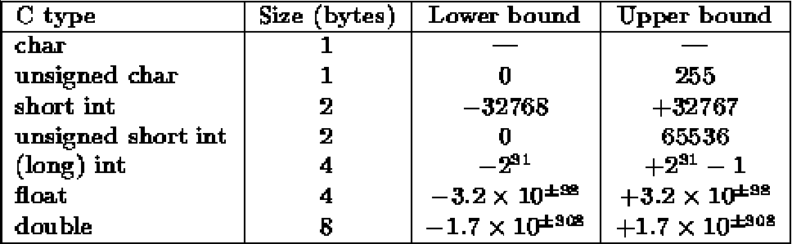
Variable Type
C has the following simple data types:
Assignment

Slide 9
Basic Types
Type (16 bit) | Smallest Value | Largest Value
short int | -32,768(-2¹⁵) | 32,767(2¹⁵-1)
unsigned short int | 0 | 65,535(2¹⁶-1)
Int | -32,768 | 32,767
unsigned int | 0 | 65,535
long int | -2,147,483,648(-2³¹) | 2,147,483,648(2³¹-1)
unsigned long int | 0 | 4,294,967,295

Slide 10
Basic Types
Type (32 bit) | Smallest Value | Largest Value
short int | -32,768(-2¹⁵) | 32,767(2¹⁵-1)
unsigned short int | 0 | 65,535(2¹⁶-1)
Int | -2,147,483,648(-2³¹) | 2,147,483,648(2³¹-1)
unsigned int | 0 | 4,294,967,295
long int | -2,147,483,648(-2³¹) | 2,147,483,648(2³¹-1)
unsigned long int | 0 | 4,294,967,295

Slide 11
Data Types
char, int, float, double
long int (long), short int (short), long double
signed char, signed int
unsigned char, unsigned int
1234L is long integer
1234 is integer
12.34 is float
12.34L is long float

Slide 12
Floating Types
float single-precision floating-point
double double-precision floating-point
long double extended-precision floating-point
Type | Smallest Positive Value | Largest Value | Precision
float | 1.17*10⁻³⁸ | 3.40*10³⁸ | 6 digits
double | 2.22*10⁻³⁰⁸ | 1.79*10³⁰⁸ | 15 digits
double x; long double x;
scanf(“%lf”, &x); scanf(“%Lf”, &x);
printf(“%lf”, x); printf(“%Lf”, x);

Slide 13
Character Types
char ch;
int i;
i = ‘a’; /* i is now 97 */
ch = 65; /* ch is now ‘A’ */
ch = ch + 1; /* ch is now ‘B’ */
ch++; /* ch is now ‘C’ */
if(‘a’ <= ch && ch <= ‘z’)
for(ch = ‘A’; ch <= ‘Z’; ch++)

Slide 14
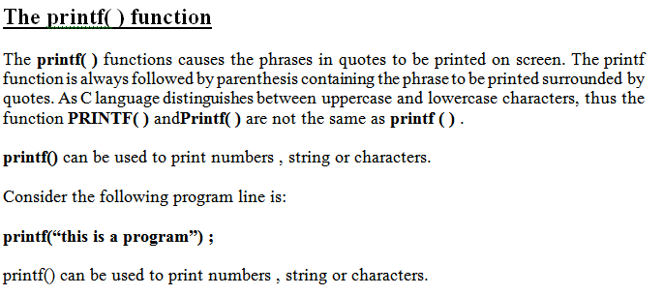
Reading and Writing Integers

Slide 15
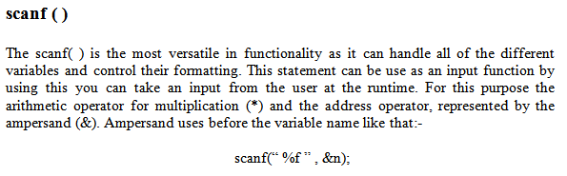

Slide 16
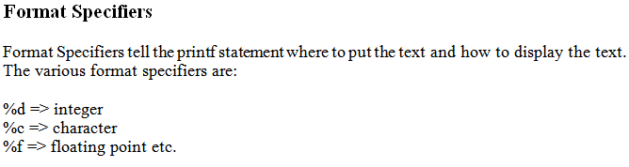

Slide 17
